Slide 1
Ducling Simulation with Simio
By: Team One

Slide 2
We calculated the pattern and created a probability matrix
Cleaning data
We removed the NA value
We calculated the conditional probability the population go from station A to station B based on the survey and the memoryless assumption.

Slide 3
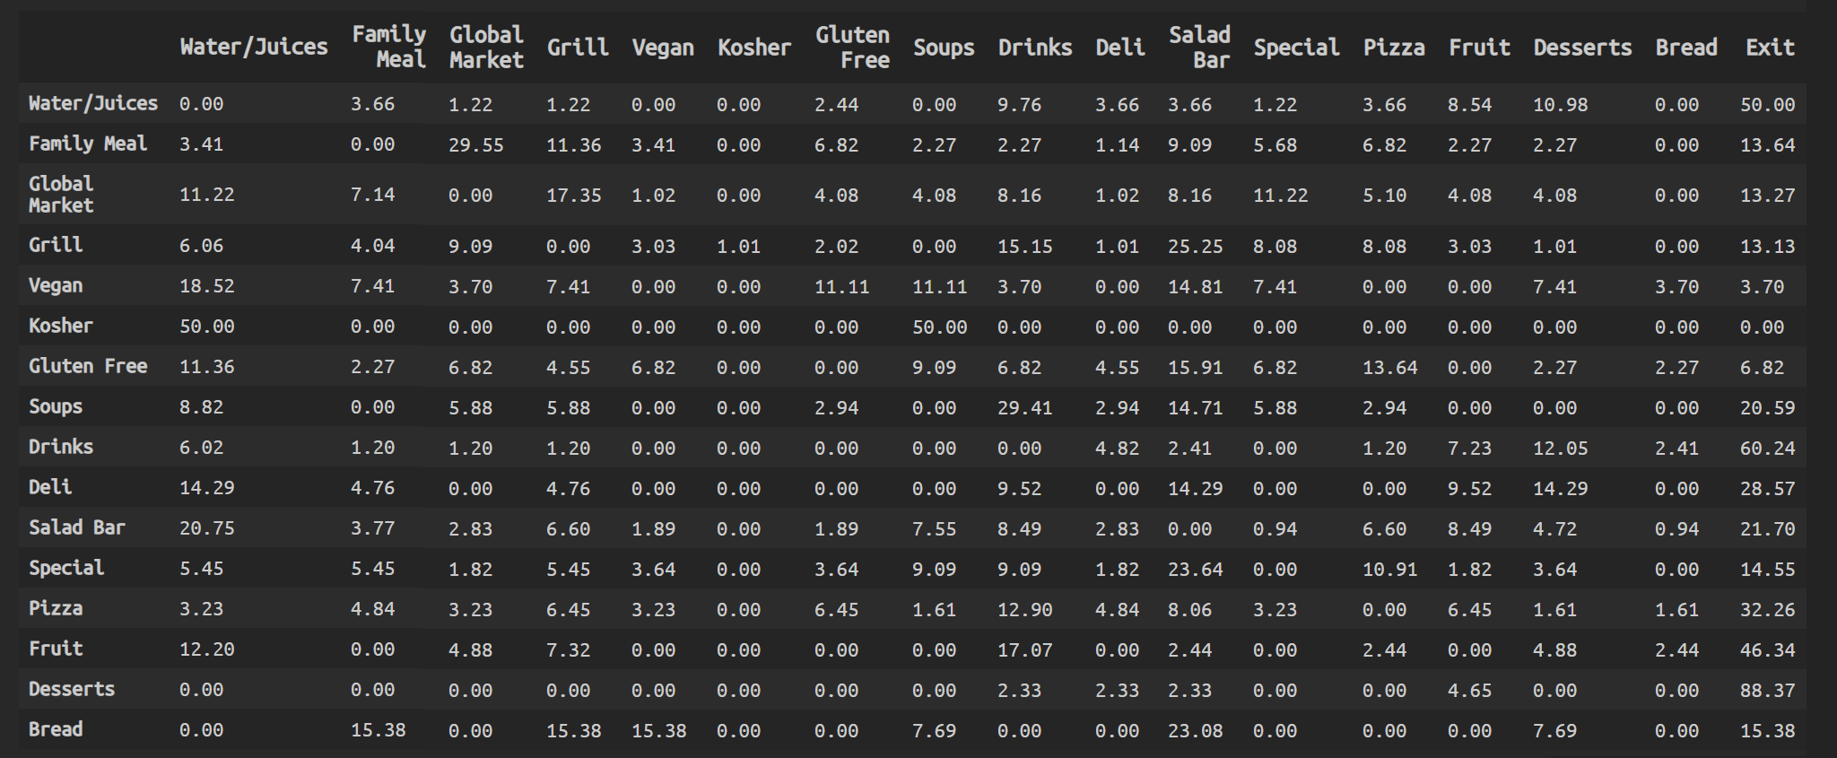
We calculated the pattern and created a probability matrix
Probability Matrix (x: to, y: from)

Slide 4
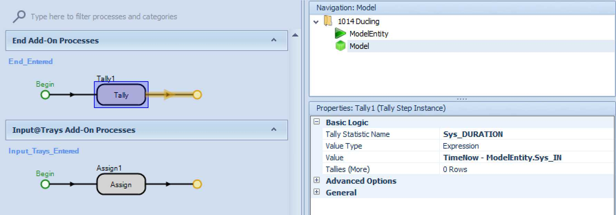
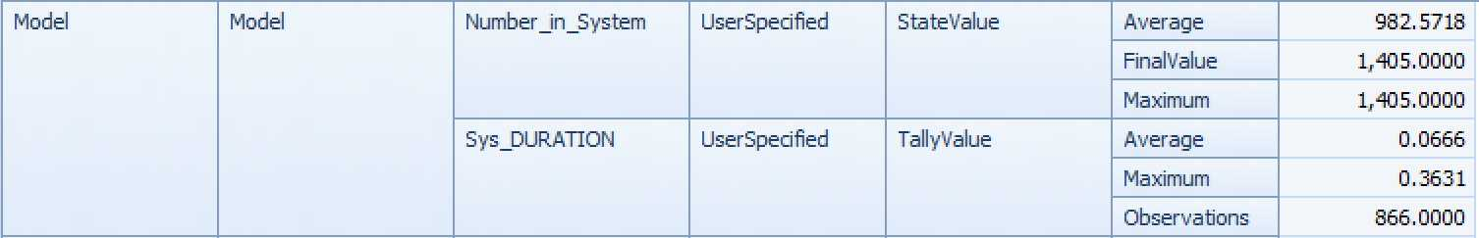
??

Slide 5
Model
Simple Model Details
Stations | 19 total 16 food 3 Check-in, Trays, Table
Paths | 290
Table Capacity | 300
Arrival Times
Arrival times were determined using the POS Data

Slide 6
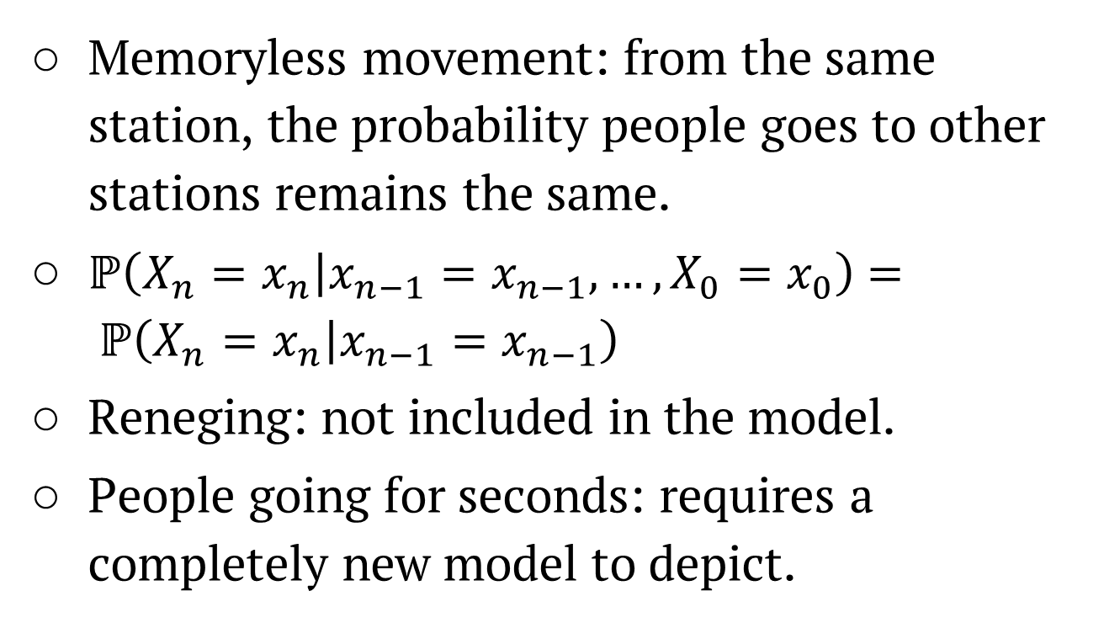
Problems and Assumptions
Memoryless movement: from the same station, the probability people goes to other stations remains the same.
$ℙ\left(X_{n}=\left.x_{n}\right|x_{n−1}=x_{n−1},…,X_{0}=x_{0}\right)$ $= ℙ\left(X_{n}=\left.x_{n}\right|x_{n−1}=x_{n−1}\right)$
Reneging: not included in the model.
People going for seconds: requires a completely new model to depict.

Slide 7
Probabilities
To calculate the route for station visits per person, we used conditional probabilities of going to any possible station contingent on the station that person had just been to

Slide 8
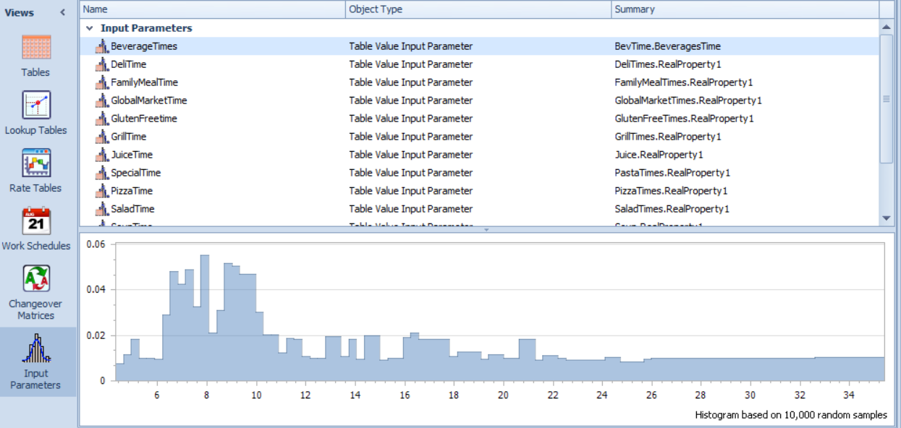
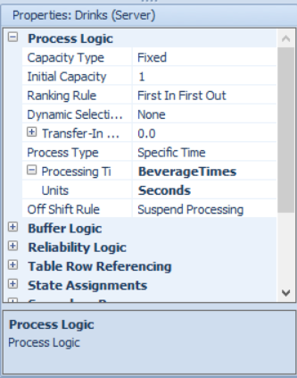
Process Time
Process times were based on the collected data
After being uploaded into a table, the distribution of the data was set to apply to 10,000 instances to reflect randomness in the model
Queues formed based on the time each individual took at a station, given that the capacity for most stations was only one

Slide 9
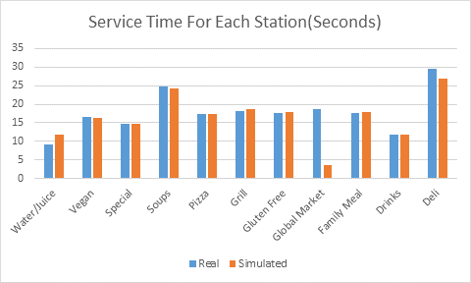
Model Validation
Comparison of number of visitors between the simulated and real situations
Comparison of service time between the simulated and real situations

Slide 10
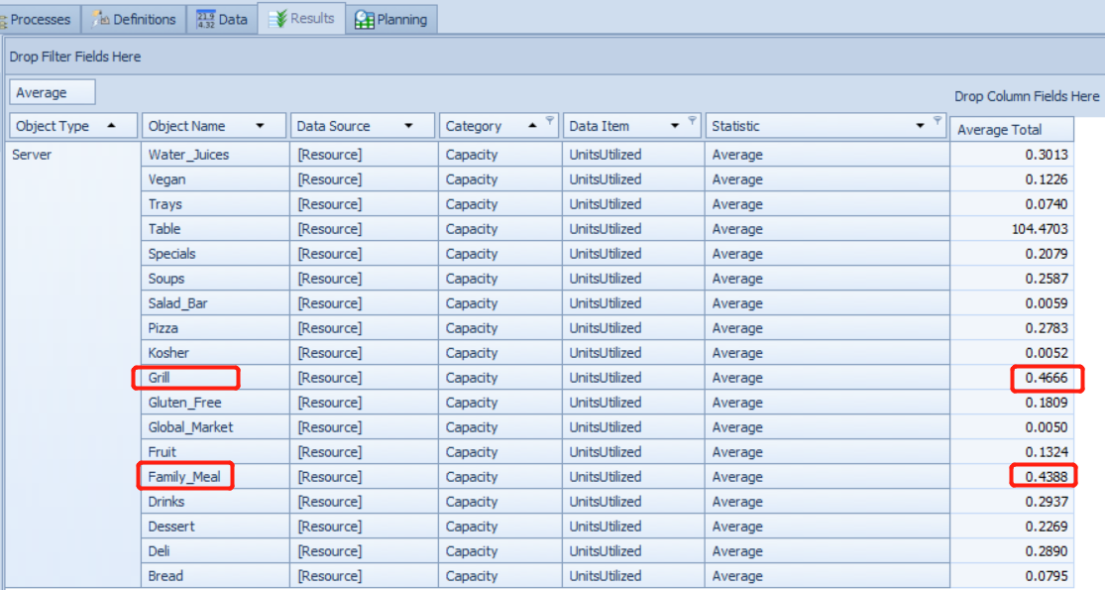
Problem Identification
Two biggest bottlenecks:
Grill
Family Meal

Slide 11
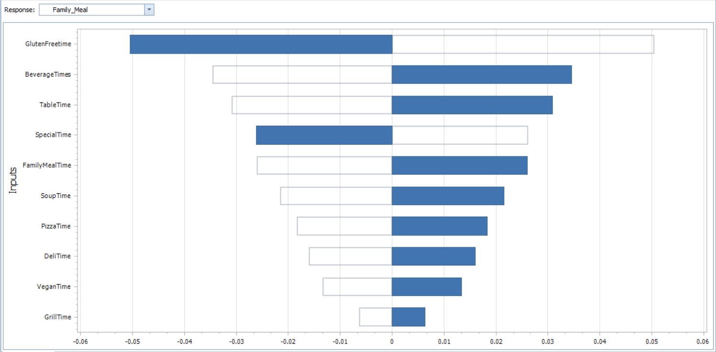
Experimenting
Unchanged
This graph represents the coefficients that affect the target variable- the utilization rate
We increased capacity by 1 for the Gluten Free and Drinks stations.

Slide 12
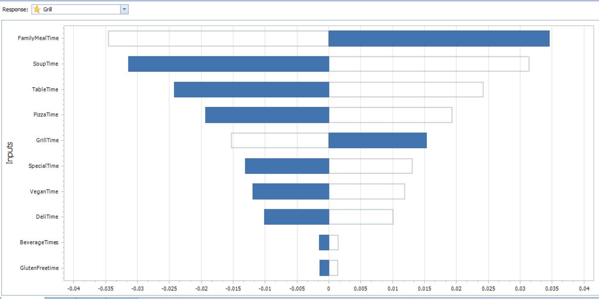
Experimenting
First Change
We increased capacity by 1 for the Family Meal and Soup stations.

Slide 13
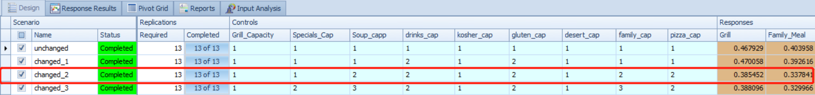
Experimenting
Result
Not much difference after the second change

Slide 14
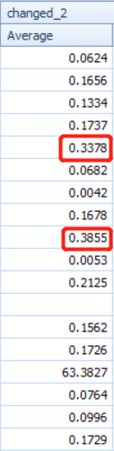
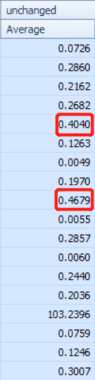
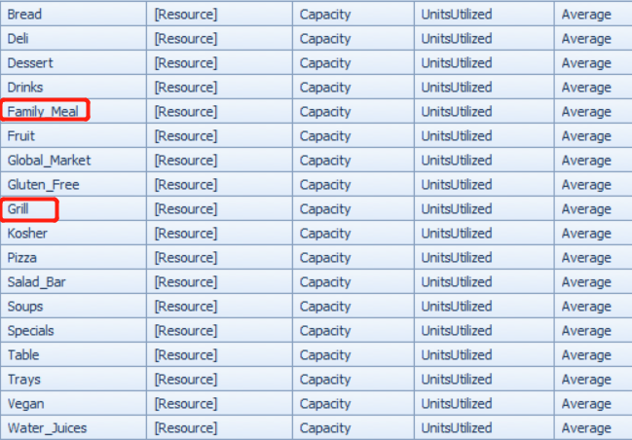
Experimenting
Result
xx
16% decrease
18% decrease

Slide 15
Conclusion
Solutions:
Increased capacity by 1 for 5 stations: Soup, Drinks, Gluten Free, Family Meal and Pizza
Reduce pressure of grill and family meal stations by distribute more customers to other stations
Future Improvement:
Collect data for the locations to send reneging entities
Collect data for the tolerable time that results in reneging
Notes:
Reduce pressure of grill and family meal stations by distribute more customers to other stations.

